Slide 1
Regression analysis
Higher School of Economics, 2020
Author: Alisa Melikyan, senior lecturer of the School of Software Engineering

Slide 2
Regression analysis
Regression analysis permits to predict some kind of outcome from one or more predictor variables.
Simple regression: predicting an outcome from a single predictor. Multiple regression: predicting an outcome from a several predictors.
In regression analysis we fit a predictive model to our data and use that model to predict values of the dependent variable from one or more independent variables.

Slide 3
Regression equation
Y_{i} = (b₀ + b₁X_{i}) + e_{i}
Y_{i} – outcome that the model predicts;
X_{i} – i_{th} case’s score on the predictor variable;
b₁ – gradient of the straight line fitted to the data;
b₀ – intercept of the line.
b₁ and b₀ are regression coefficients.
e_{i} – residual term (represents the difference between the score predicted by the line for case i and the score that participant i actually obtained.)

Slide 4
Method of least squares
Method of least squares is a way of finding the line that best fits the data (i.e. the line that goes through, or as close to, as many of the data points as possible).

Slide 5
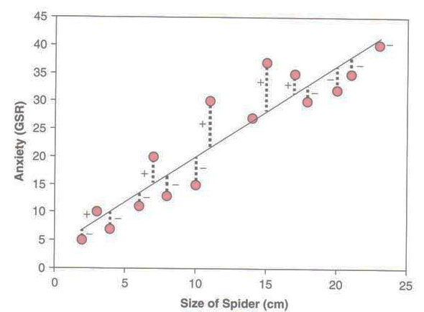
This graph shows a scatterplot of some data with a line representing the general trend. The vertical lines (dashed) represent the differences (or residuals) between the line and the actual data.
The method of least squares works by selecting the line that has the lowest sum of squared differences.

Slide 6
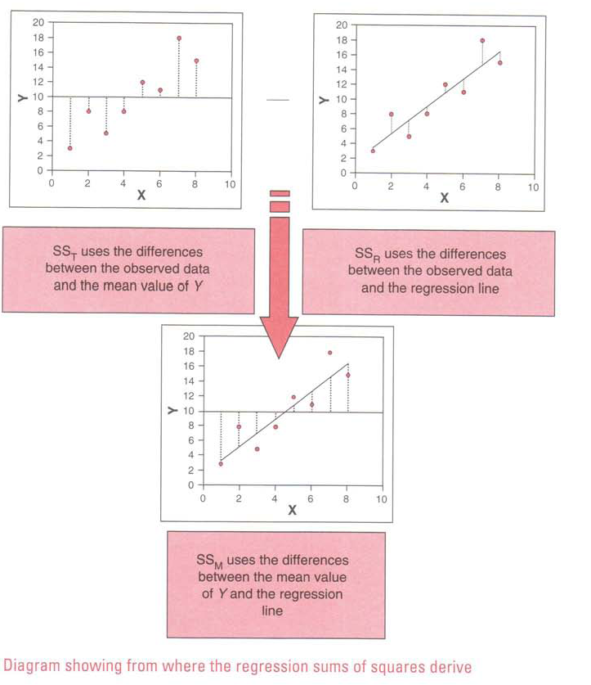

Slide 7
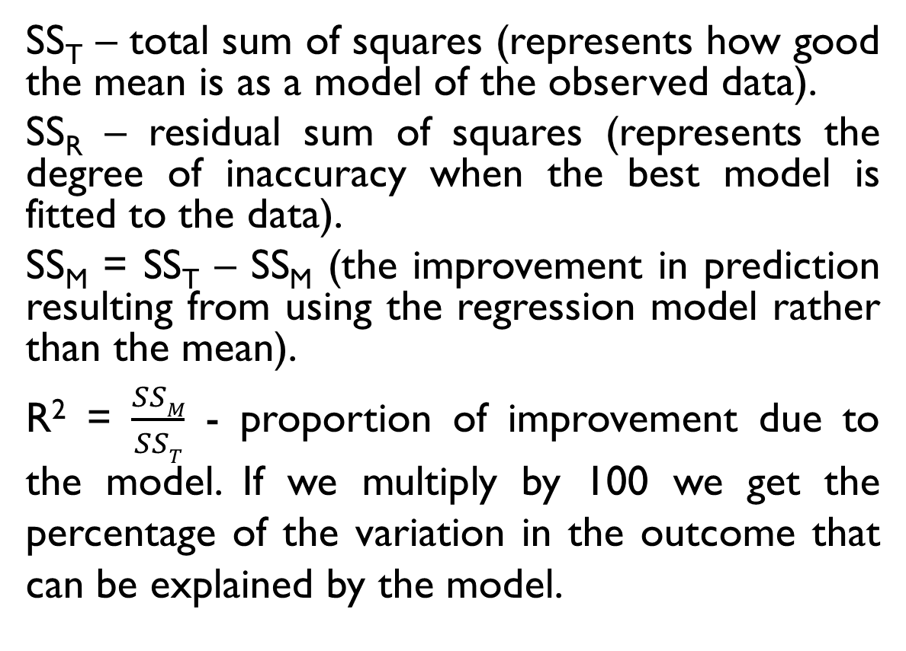
Assessing the goodness-of-fit of the model (1)
SS_{T} – total sum of squares (represents how good the mean is as a model of the observed data).
SS_{R} – residual sum of squares (represents the degree of inaccuracy when the best model is fitted to the data).
SS_{M} = SS_{T} – SS_{M} (the improvement in prediction resulting from using the regression model rather than the mean).
R² = $\frac{SSM}{SST}$ - proportion of improvement due to the model. If we multiply by 100 we get the percentage of the variation in the outcome that can be explained by the model.

Slide 8
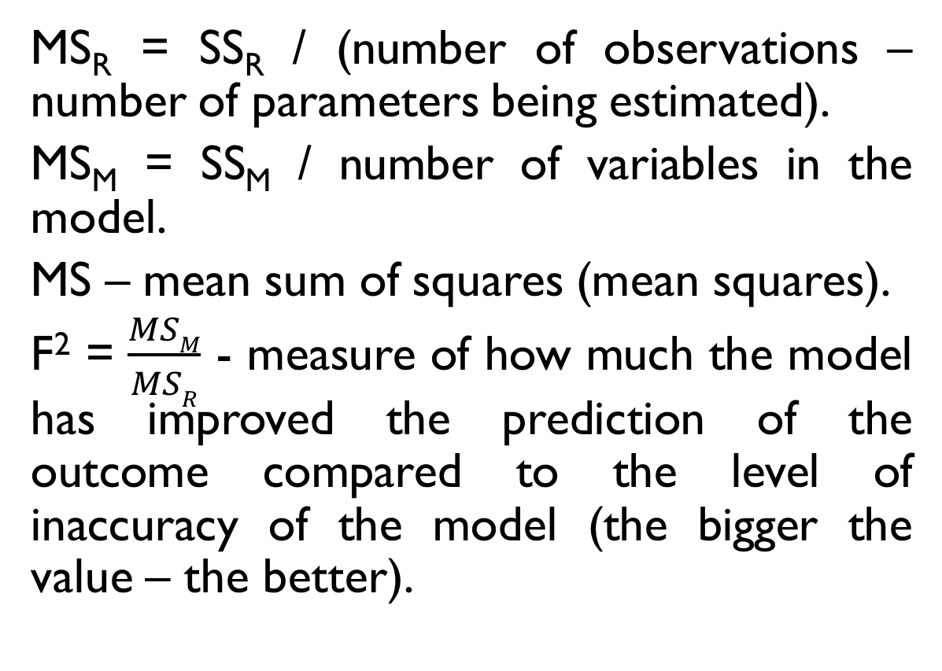
Assessing the goodness-of-fit of the model (2)
MS_{R} = SS_{R} / (number of observations – number of parameters being estimated).
MS_{M} = SS_{M} / number of variables in the model.
MS – mean sum of squares (mean squares).
F² = $\frac{MSM}{MSR}$ - measure of how much the model has improved the prediction of the outcome compared to the level of inaccuracy of the model (the bigger the value – the better).

Slide 9
Assessing individual predictors
If a variable significantly predicts an outcome, then it should have a b-value significantly different from zero. This hypothesis is tested using a t-test.

Slide 10
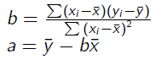
Simple example
X | Y
1 | 5
2 | 3
4 | 4
7 | 6
9 | 12
Y = 0,8*X + 2

Slide 11
Multiple regression (1)
The multiple regression model supposes that we have more than one predictor. Each predictor variable has it’s own coefficient, and the outcome variable is predicted from a combination of all the variables multiplied by their respective coefficients plus a residual term.
Y_{i} = (b₀ + b₁X₁ + b₂X₂ + … + b_{n}X_{n} ) + e_{i}

Slide 12
Multiple regression (2)
In the equation:
b₁ is the coefficient of the first predictor (X₁)
b_{n} is the coefficient of the n^{th} predictor (X_{n} )
e_{i} is the difference between the predicted and the observed value of Y for the i^{th} participant.

Slide 13
R and R² in the multiple regression model
Multiple correlation coefficient (Multiple R). It’s a correlation between the observed values of Y and the values of Y predicted by the multiple regression model.
R² is the amount of variation in the outcome variable that is accounted for by the model.

Slide 14
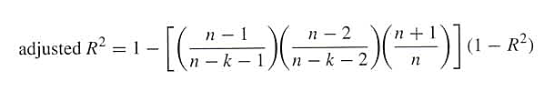
Adjusted R-squared
Adj R-squared takes into account the number of observations.
Demonstrates the predictive power of the results given the limited sample.

Slide 15
Methods of regression
How to decide which predictors to use in our model?
The predictors included and the way in which they are entered into the model can have a great impact.
It is recommended to select predictors based on past research (but it’s necessary to be sure that the past research was done appropriately).
If new predictors are being added to existing models then select these new variables based on the substantive theoretical importance of these variables.

Slide 16
Approaches of entering variables into the model
When predictors are all completely uncorrelated the order of variable entry has very little effect on the parameters calculated. However in real research we rarely have uncorrelated predictors and so the method of predictor selection in crucial.

Slide 17
Hierarchical (Blockwise Entry)
In hierarchical regression predictors are selected based on past work and the experimenter decides in which order to enter predictors into the model. As a general rule, known predictors (from other research) should be entered into the model first in order of their importance in predicting the outcome. After known predictors have been entered, the experimenter can add any new predictors into the model. New predictors can be entered all in one go, in a stepwise manner, or hierarchically (such that the new predictor suspected to be the most important is entered first).

Slide 18
Forced entry
Forced entry is a method in which all predictors are forced into the model simultaneously. Like hierarchical, this method relies on good theoretical reasons for including the chosen predictors, but unlike hierarchical the experimenter makes no decision about the order in which variables are entered.

Slide 19
Adding categorical variables into the model
If the variable is dichotomous it could be added into the model.
If the categorical variable has more than two values it should be recoded into several dummy variables. Each group of cases, defined by the values of the categorical variable, should contain not less then 15% of cases.

Slide 20
Creating dummy variables
If the categorical variable has n values we will create n-1 dichotomous variables.
One category is selected as a “basic” or “reference” and the other categories will be compared with this “basic” category. It could be a category, which contains the biggest number of cases.

Slide 21
Evaluating the accuracy of the regression model
When we have produced a model based on a sample of data two important questions should be considered:
1) Does the model fit the observed data well, or it’s influenced by a small number of cases?
2) Can the model generalize to other samples?

Slide 22
Diagnostics of the model: outliers and influential cases
An outlier is a case which differs substantially from the main trend of the data. Outliers can cause the model to be biased because they affect the values of the estimated regression coefficients.
An influential case is a case which has serious influence over the parameters of the model. If we delete it the regression coefficients will change.

Slide 23
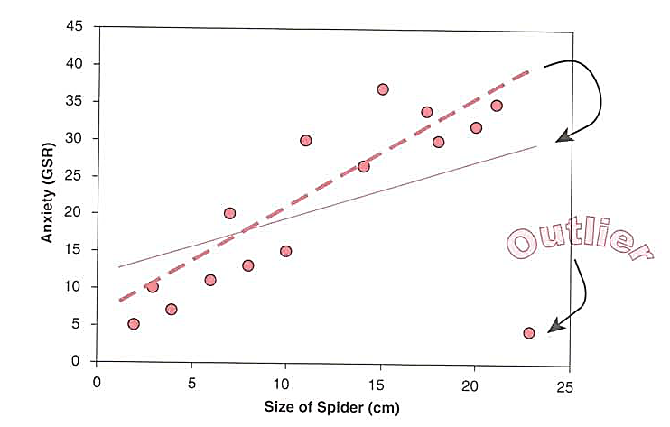
Outliers
The change in one point had a dramatic effect on the regression model: the gradient reduced (the line becomes flatter) and the intercept increases (the line crosses the Y-axis at a higher point).

Slide 24
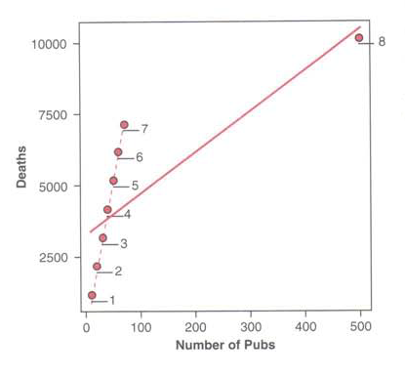
Influential cases

Slide 25
How to identify an influential case?
Influential statistics: DfBeta(s) shows how the regression coefficients change if the influential case is excluded.
The case could be an influential if the values of these statistics increase are greater than 1.

Slide 26
Diagnostics of the model: residuals
Residuals are the differences between the values of the outcome predicted by the model and the values of the outcome observed in the sample. If the model fits the sample data well then all residuals will be small.
If a particular case has a large residual then it could be an outlier.

Slide 27
Multicollinearity
Situation when there is a strong correlation between two or more predictors in a regression model.
VIF (variance-inflation factor). The VIF indicates whether a predictor has a strong linear relationship with the other predictor(s). If VIF is greater than 10 or mean of the VIFs is greater than 1 there could be a multicollinearity.
Tolerance = 1 /VIF. If the value of Tolerance is less than 0,2 there is a problem of multicollinearity.

Slide 28
Heteroscedasticity (1)
It is supposed that in good regression models the variance of the residuals is homogeneous across levels of the predicted values (homoscedasticity). If the model is well-fitted, there should be no pattern to the residuals plotted against the fitted values. If the variance of the residuals is non-constant then there is a heteroscedasticity.
The graphical analysis could detect heteroscedasticity. A commonly used graphical method is to use the plot to show the residuals versus fitted (predicted) values.

Slide 29
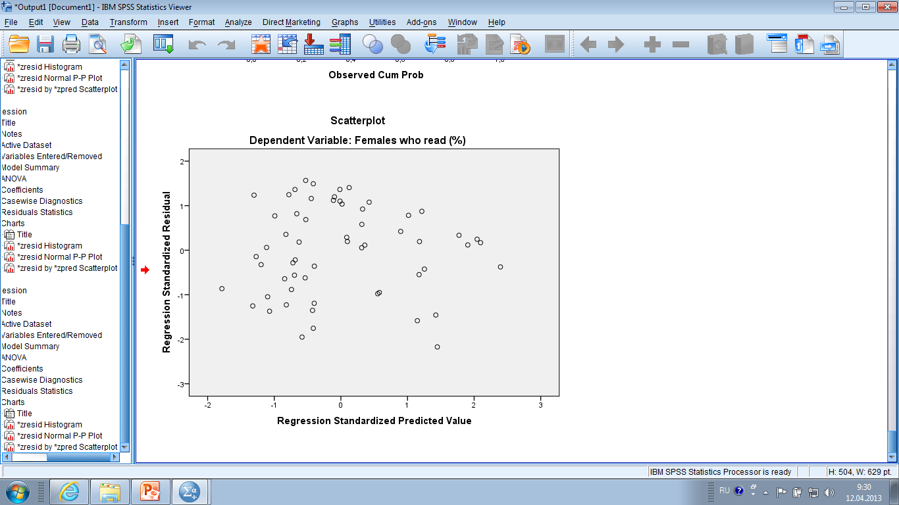
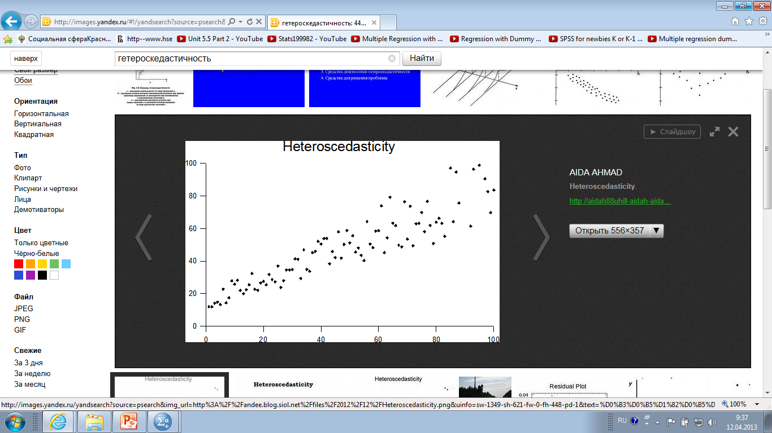
Heteroscedasticity (2)

Slide 30
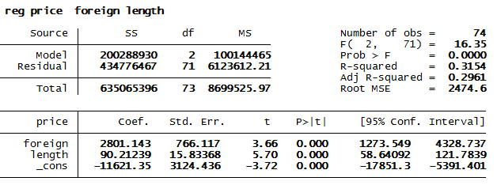
Linear Regression
Regression coefficients
Equation:
price = -11621.4 + 2801.1*foreign + 90.2*length
Significance of coefficients
Significance of the model and R-squared

Slide 31
Regression analysis in Stata
Calculate standardized coefficients: reg dep ind1 ind2, beta
Add dummy variables: xi:reg wage i.race
tabulate race, gen(newvar)

Slide 32
Residuals
predict r, resid/rstandard
Testing normality: swilk r
Graphical representation: kdensity r, normal

Slide 33
Diagnostics
Multicollinearity: estat vif
Heteroscedasticity: estat hettest
Influential cases: dfbeta

Slide 34
Heteroscedasticity on the graph
Create a graph: rvfplot

Slide 35
Predicting values of dependent variables
display _b[_cons] + _b[var_ind]*40
margins, at (age = (40))
margins, at (age=(30(10)50))
margins, at (age=(30) sex=(2))

